Slide 1

Choosing Future Career Location with Preferences and Data Analysis
Marlow M. Ghorstygrbrakoxfdeis
December 14, 2020

Slide 2
Agenda
Introduction
Problem Statement
Data Sources
Methods
Results
Discussion
Conclusion

Slide 3
Introduction
Moving to a new location can be difficult
  Many variables
  Criteria
  Stress
Ways to reduce stress could include:
  Narrowing number of choices
  Prioritizing criteria

Slide 4
Problem Statement
How can someone find their next location to move with their family while reducing stress and improving decision priorities?

Slide 5
Data Sources
FourSquare API
  Geolocation Data
  Venues
https://www.neighborhoodscout.com/
  Crime Rates
  School Quality
https://www.greatschools.org/
  School Quality

Slide 6


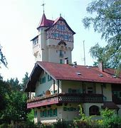
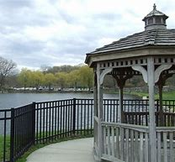
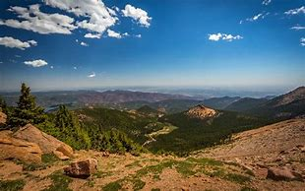
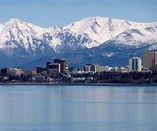
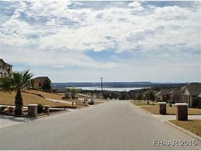
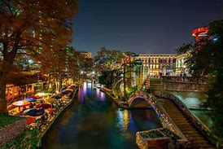
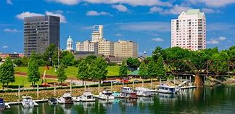
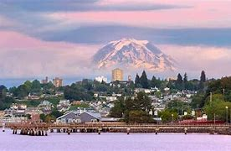
Methods (part 1)
Using these four cities to create venue fingerprints:
Budapest, Hungary
Prague, Czech Rep.
Grafenwoehr, Germany
Highland Falls, NY
To compare with these possible move locations:
Colorado Springs, CO
Anchorage, AK
Harker Heights, TX
San Antonio, TX
Augusta, GA
Tacoma, WA

Slide 7
Methods (part 2)
FourSquare API
  Coordinates for cities, schools, venues, and water venues (water, lake, river, ocean)
Neighborhoodscouts.com
  Crime Rates, school quality ratings
Greatschools.org
  School quality ratings and rankings within a location

Slide 8
Methods (part 3)
FourSquare API
  Coordinates for cities, schools, venues, and water venues (water, lake, river, ocean)
Neighborhoodscouts.com
  Crime Rates, school quality ratings
Greatschools.org
  School quality ratings and rankings within a location
Jupyter Notebook
  Pandas
  K-means Clustering algorithm

Slide 9
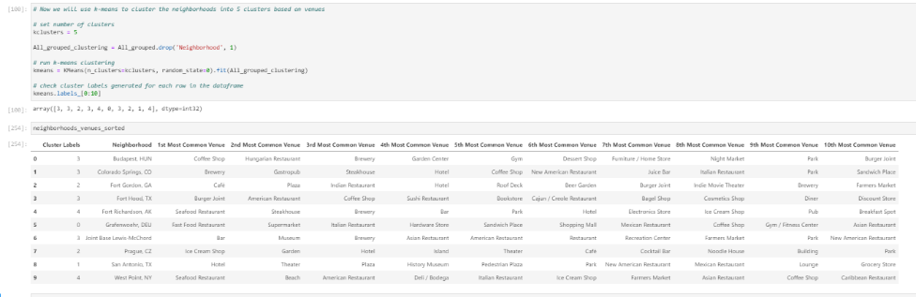
Results (part 1)

Slide 10
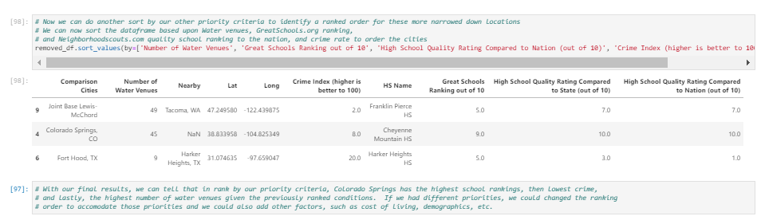
Results (part 2)

Slide 11
Discussion (part 1)
Given that our first priority was to locate similar places to places that we have enjoyed living, clustering was a great way to do this. The sorting algorithm identified venue similarities, with three of the cities having parks as their 9th venue, and Fort Hood (Harker Heights) and Joint Base Lewis-McChord (Tacoma, WA) having Sushi and Asian Restaurants, and Colorado Springs and Joint Base Lewis-McChord (Tacoma, WA) both having New American Restaurants.
Given that our favorite comparison city was Budapest, Hungary, we used that cluster (cluster #3) to apply sorting criteria in the following remaining priorities order: 2) Identify places with scenery, somewhat rural, with water nearby, such as rivers, lakes, etc., 3) Identify places with the best schools, and 4) Identify places with lower crime rates.

Slide 12

Discussion (part 2)
With our final results, in rank order by our priority criteria, Joint Base Lewis-McChord has the most water venues, highest school rankings,and lowest crime, given the previously ranked conditions. If we had different priorities, we could change the ranking order to accomodate for those new or different priorities and we could also add other factors, such as cost of living, demographics, or other criteria of interest.
#2
#3
#1
Colorado Springs, CO
Harker Heights, TX
Tacoma, WA

Slide 13
Conclusion (part 1)
This project's aim was to reduce stress in the decision making process for the next career move by using data sets, tools, and analysis to propose possible solutions for our next location using the FourSquare API, web scraping, and other data sources to meet the following established priority criteria: 1) Locate places similar to places that we have enjoyed living previously, 2) Identify places with scenery, somewhat rural, with water nearby, such as rivers, lakes, etc., 3) Identify places with the best schools, and 4) Identify places with lower crime rates.
By using the k-means clustering algorithm, we were able to meet the objectives of our first priority, which then set the conditions for rank ordering the remaining priority criteria. The results of clustering provided a way to scope down six cities using four comparison cities of places we truly enjoyed living in order to better identify potential future locations to move.

Slide 14
Conclusion (part 2)
Joint Base Lewis-McChord (Tacoma, WA) was the winner for the highest ranked next location to move, given the most water venues, highest school rankings, lowest crime, and given the previous cluster (cluster #3) that we targeted from our k-means analysis.
This method for analysis provided our top move location out of six, reducing our analysis window to one sixth its original size.
The rank ordering enabled us to continue to look even closer at the neighborhoods within the Tacoma, Washington area, and these tools and analysis have truly made something daunting into something much more manageable, thereby reducing stress.

